Slide 1
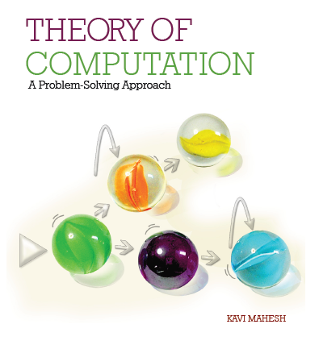

Theory of Computation: A Problem-Solving Approach
Chapter – 5: Grammars

Slide 2
Learning Objectives
Learn how grammars can be more compact than regular expressions.
Learn how grammars are used to parse or derive strings in a language.
Learn how to construct grammars for regular languages.
Learn to convert automata to regular grammars.
Learn to convert regular grammars to automata.

Slide 3

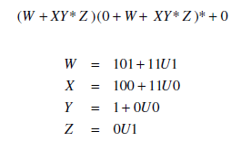
The Idea of a Grammar
Regular expressions are not always concise. E.g., numbers divisible by 5:
Grammars allow us to assign variable names for patterns so that they can be reused
Grammars are used to describe the structure of strings in a language
Above RegEx can be rewritten as:
Where U = (01)*(1 + 00)

Slide 4
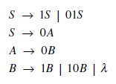
Grammar
A grammar G has:
Rules of the form x → y called productions
Symbols from the alphabet are called terminals
Variables are called non-terminals
E.g., for the language of binary strings with exactly one pair of consecutive 0 s
RegEx: (1 + 01)*00(1 + 10)*
Grammar:

Slide 5
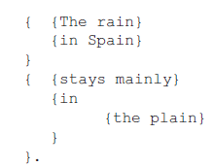
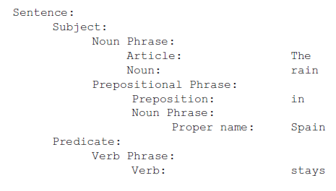
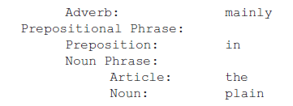
Example: English Sentence
The rain in Spain stays mainly in the plain.

Slide 6
Grammar Example
a valid English sentence is made up of a subject and a predicate;
the subject is a noun phrase;
the predicate is a verb phrase (if the verb is transitive, it has an object noun phrase);
noun phrases are made up of either an article and a noun or just a proper name;
verb phrases are made up of a verb (and an optional adverb)
noun and verb phrases can also have an optional prepositional phrase that in turn is made up of a preposition and a noun phrase.
Sentence → Subject Predicate
Subject → Noun_Phrase
Predicate → Verb_Phrase [Noun_Phrase]
Noun_Phrase → [Article Noun | Proper_Name] [Prepositional_Phrase]
Verb_Phrase → Verb [Adverb] [Prepositional_Phrase]
Prepositional_Phrase → Preposition Noun_Phrase

Slide 7
The Ideas of Parsing and Derivation
Parsing: Given a string in the language, construct a tree-structure according to the grammar
Symbols in the string are the leaves of the parse tree
Internal nodes are the non-terminals in the grammar
The root node of the parse tree is the start symbol S
Each internal node and its immediate child nodes constitute a production rule in the grammar
As we go up the tree, we get shorter “sentential forms”
Any string in the language can be parsed to arrive at S
Derivation: Starting from the symbol S, expand using production rules of the grammar to arrive at the given string at the leaf nodes of the derivation tree.
Opposite of parsing
Start symbol S can derive every string in the language of the grammar
Derivation expands variables to generate longer sentential forms

Slide 8


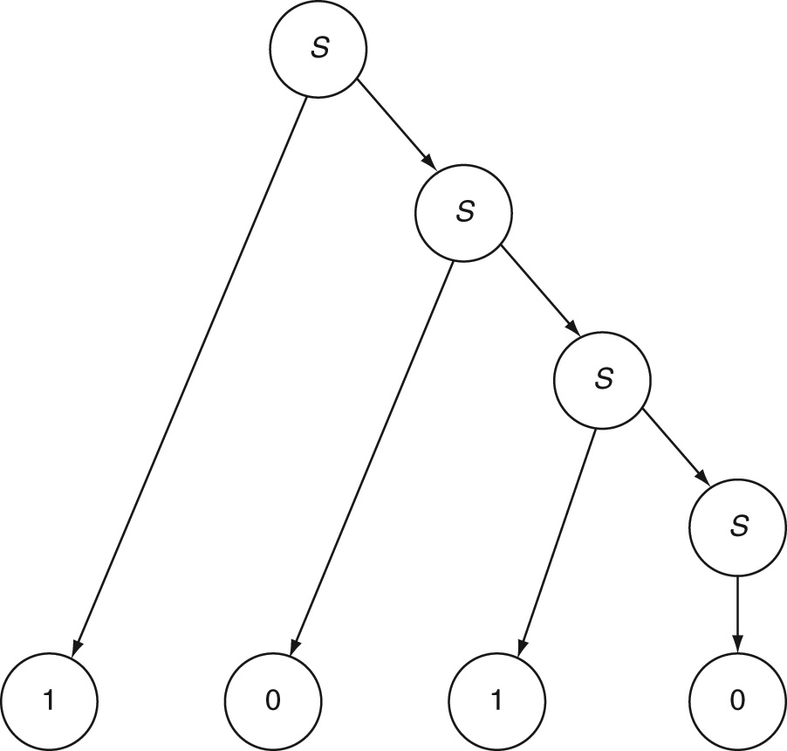
Parsing: Example 5.1
Right-Linear Grammar for even numbers: S → 0S, S → 1S, S → 0
Given 1010
Parsing:
Derivation:
Tree

Slide 9
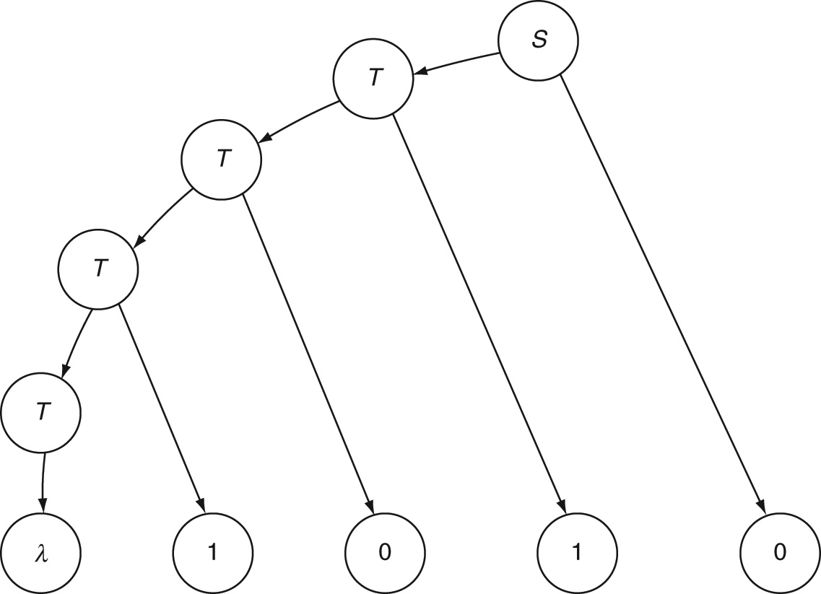
Derivation: Example 5.2
Left-Linear Grammar for even numbers: S → T0, T → T0, T → T1, T → λ
Given 1010 derivation is:
Tree:

Slide 10
Regular Grammars
Must be right-linear or left-linear
Every production has just one non-terminal and no terminal on the left-hand side
Linear: only one non-terminal on the right-hand side of every production
Right-linear: Non-terminal is the rightmost symbol on the right-hand side of every production
Left-linear: Non-terminal is the leftmost symbol on the right-hand side of every production
No mixing: some productions being right-linear and some others being left-linear in the same grammar is not allowed

Slide 11
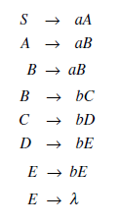
Constructing Grammars: Example 5.3
Two or more a s followed by three or more b s, i.e., a^{n}b^{m}, n ≥ 2, m ≥ 3

Slide 12
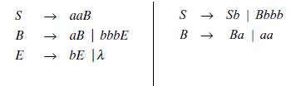
Equivalent Grammars: Example 5.3
More compact right-linear grammar and left-linear grammar

Slide 13
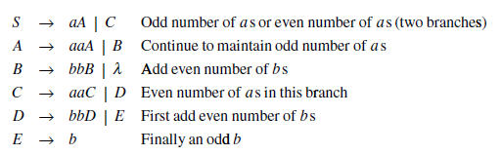
Constructing Grammars: Example 5.4
Some a s followed by some b s, the total number being odd

Slide 14
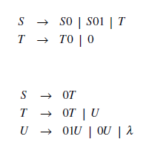
Constructing Grammars: Example 5.5
Language of the RegEx 00*(01 + 0)*
Left-linear grammar:
Right-linear grammar:

Slide 15
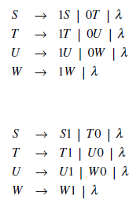
Constructing Grammars: Example 5.6
Binary strings with at most three 0s
Right-linear grammar
Left-linear grammar

Slide 16
Mantras for Regular Grammars
What is the simplest string in the language?
What are some other strings in the language?
What are all the other strings in the language?
Is the null string a member of the language?
With what symbols do strings in the language begin and end?
What does an equivalent automaton need to remember?
What are all the productions for each variable in the grammar?

Slide 17
Mantras for Grammars (contd..)
When can derivation end?
Grammars are not constrained to behave deterministically.
In constructing a regular grammar for a language, write a regular expression first; it is often easier to translate a RegEx to a grammar than to conceive the production rules directly.
Set theoretic thinking is often useful.
In particular, try to split the language into two or more sublanguages that are easier to handle; then, combine the grammars mutually exclusively by adding a production of the form S → S₁ | S₂ | ... where the variables S₁, S₂, and so on will derive the individual sublanguages.
Just as in the case of regular expressions, there is no need to introduce the equivalent of a reject state in a grammar.
Finally, just as in the case of automata and regular expressions, do not try to merge branches that were created for mutually exclusive sublanguages. In the case of grammars, usually separate variables denote different branches.

Slide 18
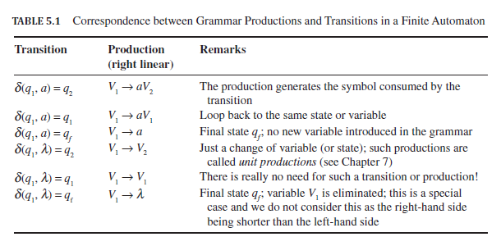
Automata to Regular Grammars

Slide 19
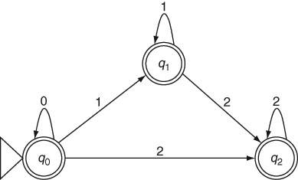
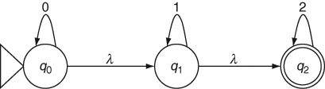
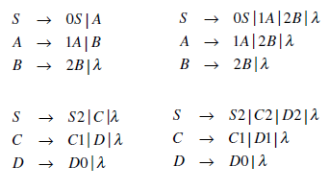
NFA to Grammar: Example 5.7
0s, 1s and 2s in that order
NFA and DFA
Right-linear grammars
Left-linear grammars

Slide 20
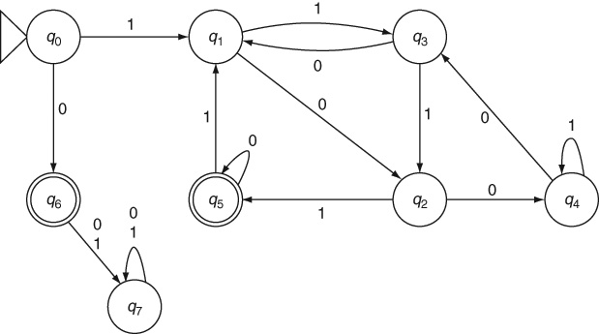
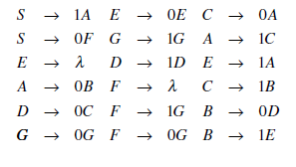
DFA to Grammar: Example 5.8
Binary numbers divisible by 5
DFA
Grammar

Slide 21
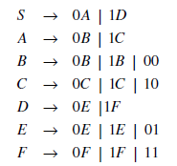
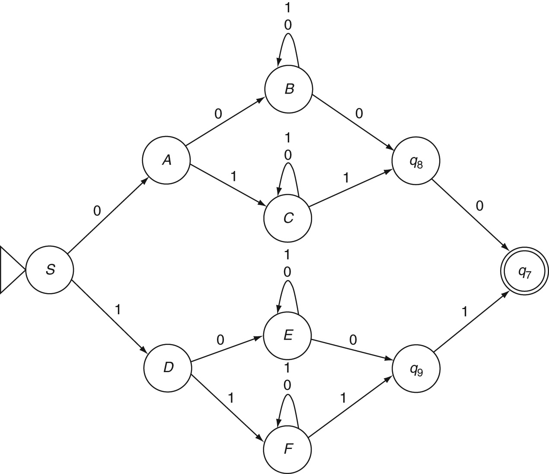
Regular Grammar to NFA: Example 5.9
Binary strings with the last two symbols being a reverse of the first two symbols
RegEx: 0(0(0 + 1)*0 + 1(0 + 1)*1)0 + 1(0(0 + 1)*0 + 1(0 + 1)*1)1
Grammar:
NFA:

Slide 22
Theorems
Theorem 5: Equivalence of Right-Linear Grammar and NFA: For every right-linear grammar, there is an equivalent NFA that accepts the same language as the language of the grammar.
Theorem 6: Equivalence of Right and Left-Linear Grammars: For every right-linear grammar, there is an equivalent left-linear grammar whose language is the same as that of the right-linear grammar.

Slide 23
Key Ideas
A grammar is a set of production rules.
Grammars are sometimes more compact than regular expressions. They allow patterns to be assigned to variables or non-terminals which can be reused in other production rules.
The set of all strings that obey all the rules of a grammar is called the language of the grammar. Each of those strings can be parsed or derived using the grammar.
Parsing and derivation are inverse processes. A string in the language of a grammar can be derived from the start symbol S by expanding it repeatedly using some or all of the production rules in the grammar.
A string belonging to the language of a grammar can also be parsed by replacing terminal symbols with non-terminals according to the production rules until only the symbol S remains.
Strings used during parsing or derivation that contain both terminals and non-terminals are called sentential forms.

Slide 24
Key Ideas (contd..)
A regular grammar is a right-linear or left-linear grammar.
The language of a regular grammar is a regular language.
Regular grammars are equivalent to regular expressions and finite automata.
A regular grammar can be converted to an equivalent finite automaton and vice versa.
An automaton changes states to remember something. A regular expression introduces a concatenation. A regular grammar changes variables to remember something.
Although there is no algorithm to design a grammar, the set of mantras presented earlier help us in designing an accurate regular grammar for a given problem.

Slide 25
End of Chapter 5

